Slide 1
The School Meals Service: Past, Present and Future? (ESRC, 2023-2025)
HES CONFERENCE SHEFFIELD NOVEMBER 2023
PROF GARY MCCULLOCH & DR LAURA NEWMAN

Slide 2
Talk structure
Introduction (Gary McCulloch)
Object biography: the wartime cabbage (Laura Newman)
The sensory dimensions of school feeding in wartime Hertfordshire (Laura Newman)
Conclusions (Gary McCulloch)

Slide 3
The School Meals Service project Gary McCulloch Laura Newman (IOE) Heather Ellis Isabelle Carter (Sheffield) Gurpinder Lalli Ellen Bishop (Wolverhampton) Website: www.theschoolmealsproject.co.uk X (Twitter) a/c: @ESRCSchoolMeals
Strand 1: Policy history
Strand 2: Social history
Strand 3: Ethnographic case studies

Slide 4
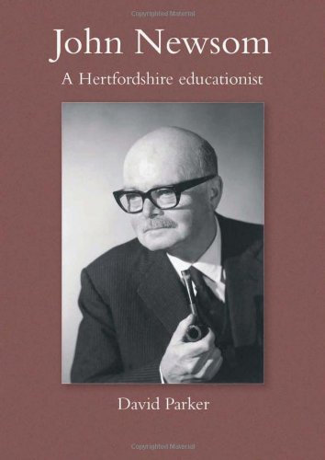
Local provision of school meals
Hertfordshire and John Newsom
Three phases of School Meals Service, based on legal framework
1906 – Education (Provision of Meals) Act
1944 – Education Act
1980 – Education Act

Slide 5
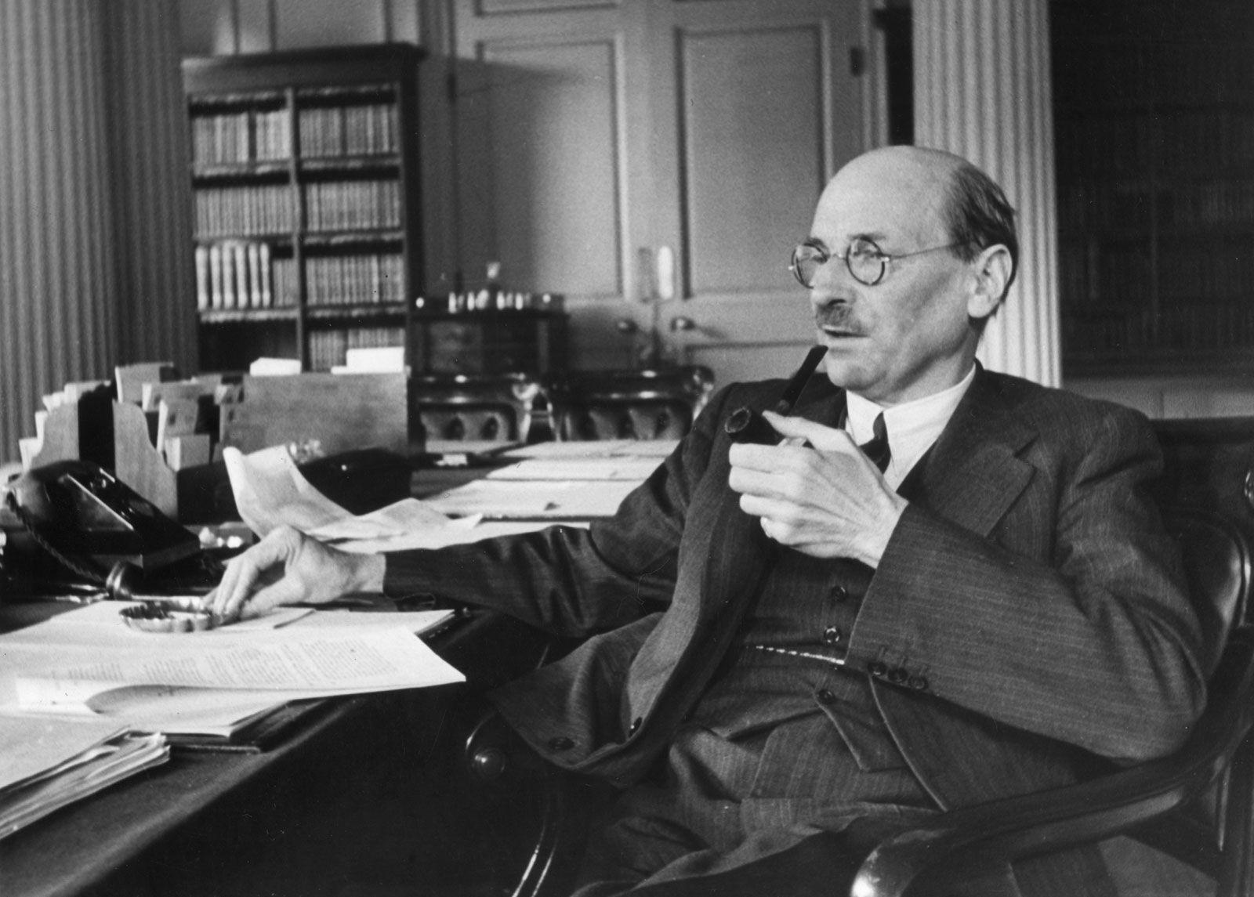
A political issue Hungry children Clement Attlee, Lord Privy Seal Lord Woolton, Ministry of Food R.A. Butler, Ministry of Education
ECONOMY: REINFORCED BY 1921 EDUCATION ACT
RATIONALE OF MALNUTRITION
INCONSISTENT IN ENFORCEMENT AND INTERPRETATION
HUNGRY CHILDREN
LOCAL ACTIVISM

Slide 6
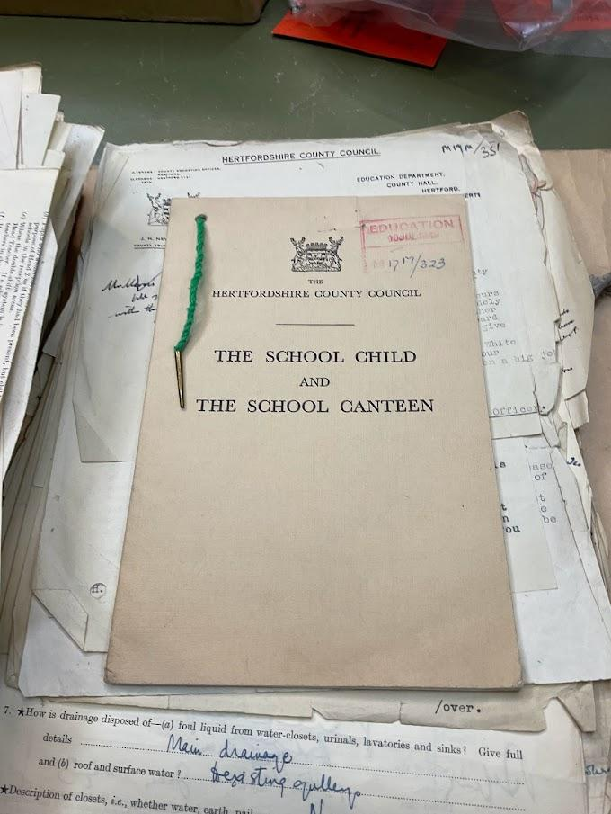
Frederick LeGros Clark II (1898-1977)

Slide 7
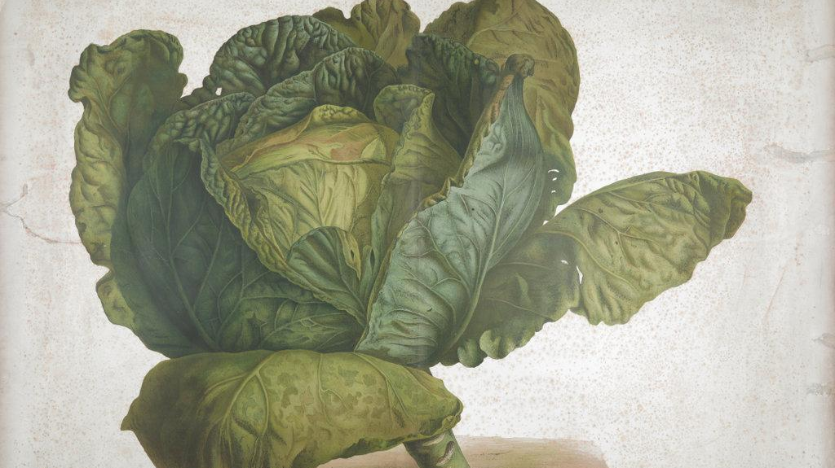
2. Object biography: the
cabbage
Source: The British Library

Slide 8
Group | Number | Number refusing greens | Approx % refusing greens
Boys 5-10 | 18 | 7 | 39
Girls 5-10 | 26 | 14 | 54
Boys 10-13 | 23 | 8 | 35
Girls 10-13 | 9 | 4 | 44

Slide 9
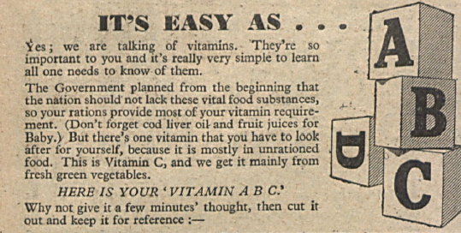
Source: Answers (30 January 1943): 14

Slide 10
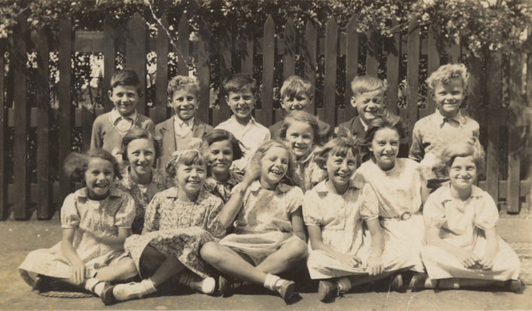
2. The sensory dimensions of school feeding in wartime Hertfordshire

Slide 11
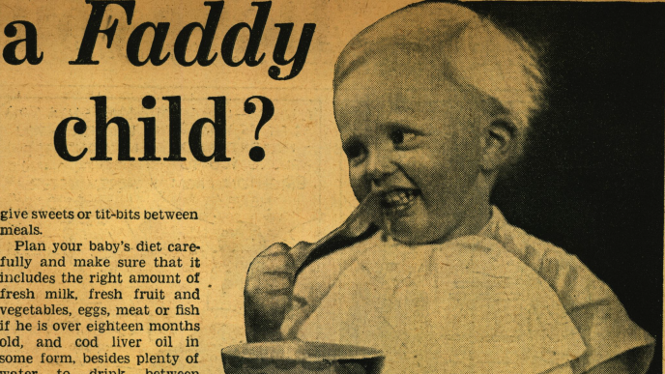
Source: The Daily Mirror, 15th April 1936

Slide 12
Any further remarks? E-mail me at laura.c.newman@ucl.ac.uk OR tweet me @laura_c_newman

Slide 13
A new School Meals Service? - Welfare State - A social institution? - Part of the school curriculum - A right and a duty? - Compulsory provision for LEAs – and pupils

